Slide 1
Mininet-WiFi exercise (Part 1)
Course 34351 Access- and Home Networks

Slide 2
Mininet-WiFi exercise
The Mininet-WiFi exercise is one of the mandatory exercises in course 34351
Takes place over four consecutive weeks:
Date | Topic
2024-02-08 | Introduction to Mininet-WiFi, Getting the software installed and tested ✓
2024-02-15 | Exercise part 1 (today)
2024-02-22 | Exercise part 2
2024-02-29 | Wrap-up if there are parts you’re missing – otherwise work on your journal
2024-03-06 | Deadline for handing-in the journal to the assignment on DTU Learn @23.59

Slide 3
Mininet-WiFi exercise (2)
Hand-in of reports: Individually or in groups of 2 students
Deadline: Wednesday, March 6 at 23.59
You have to join a group on Learn to be able to hand-in
Even if you work individually (i.e., if you’re a one-person “group”)
Go to My Course => Groups on Learn
Find an empty group (“0/2 members”)
Click on group to join (should be done by both of you for two-person groups)
Contact me if you have trouble with groups

Slide 4
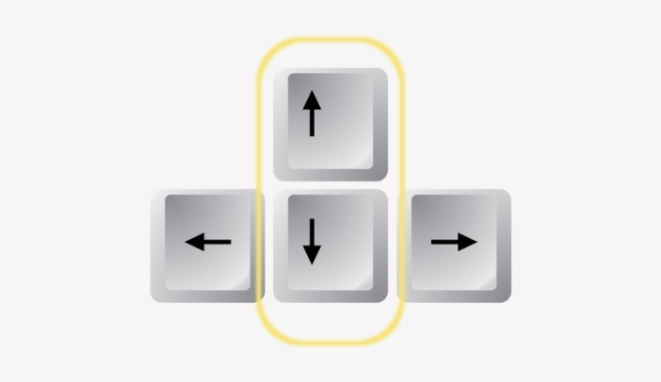
General tips
Disable Linux’s built-in network-manager (must be done every time the VM is started):
Linux CLI: sudo systemctl stop NetworkManager.service
Saving Mininet-WiFi output (but unfortunately not your input):
Linux CLI: sudo python myscript.py 2>&1 | tee outputfile.txt
Resetting Mininet-WiFi (good practice if the emulator is not terminated correctly):
Linux CLI: sudo mn -c
Use the up and down arrow keys on your keyboard to quickly scroll up and down in your command history. (Works both in the Linux CLI and the Mininet-WiFi CLI)

Slide 5
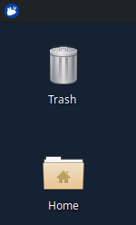
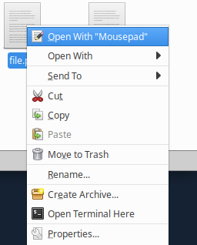
General tips (2)
Click on the Home icon to open a file manager
Right-click on a file and select Open With “Mousepad” to open it in a text editor

Slide 6
Custom network topologies in Mininet-WiFi
Mininet-WiFi has a few built-in topologies
You experimented with a simple topology (one access point and two stations) last week
But what if I want to emulate a WiFi network with another topology?
Possible to define a custom topology using Python programs

Slide 7
Simple structure
# *** DON'T CHANGE THE NEXT FOUR LINES
import sys
from mininet.log import setLogLevel, info
from mn_wifi.cli import CLI
from mn_wifi.net import Mininet_wifi
# Function that defines the network topology
def topology(args):
# DO NOT EDIT - Statements that create an empty network and add a controller - DO NOT EDIT
net = Mininet_wifi()
c1 = net.addController('c1')
# ADD NODES AND LINKS AND BUILD/START THE NETWORK
info("*** Running CLI\n")
CLI(net)
info("*** Stopping network\n")
net.stop()
if __name__ == '__main__':
setLogLevel('info')
topology(sys.argv)
This is where you write the code that defines the network

Slide 8
Adding nodes – WiFi devices
Note: Variable net is the instance of the Mininet-WiFi class from the previous slide
The examples below should be on one line in your source code
Access points: ap1 = net.addAccessPoint('ap1', other named arguments)
Example: ap1 = net.addAccessPoint('ap1', ssid = 'mywifi', mode = 'g', channel = '1', position = '100,100,0')
Wireless stations: sta1 = net.addStation('sta1', other named arguments)
Example: sta1 = net.addStation('sta1', ip = '192.168.0.1/24', position = '50,50,0')
Note: After adding APs and STAs: net.setPropagationModel(model="logDistance", exp=4.5) net.configureWifiNodes()

Slide 9
Adding nodes – Wired devices
Note: The variable net is an instance of the Mininet-WiFi class
Wired hosts: h1 = net.addHost('h1', other named arguments)
Example: h1 = net.addHost('h1', ip = '192.168.0.2/24')
Switches: sw1 = net.addSwitch('sw1', other named arguments)
Example: sw1 = net.addSwitch('sw1')
Adding a wired link: net.addLink(device1, device2)
Example: net.addLink(h1, sw1) connects h1 and sw1 with a wired link

Slide 10
Starting the network
net.build()
c1.start() # Start the controller
ap1.start([c1]) # For access points
sw1.start([c1]) # For switches – leave out if there are no switches
See https://mininet-wifi.github.io for more inspiration

Slide 11
Python notes
Python issues an error message if you use different forms of indentation in your code, e.g., both spaces and tab. To be consistent you must use four space for every level of indentation, e.g., ( ∙ ≈ space) def myfunc(x): ∙∙∙∙if x>=0: ∙∙∙∙∙∙∙∙return x ∙∙∙∙else: ∙∙∙∙∙∙∙∙return -x
Python uses indentation for scoping
Lines are not terminated with semicolons
For simple comments, use pound-sign (#), e.g., # THIS IS A COMMENT
Named arguments are in the form name = value, e.g., net.addAccessPoint('ap1', ..., mac = '00:01:02:03:04:05', ...)

Slide 12
Access to class methods and fields
Devices (AP, stations, hosts, ...) are represented by Python classes in Mininet-WiFi
=> Possible to manipulate directly using: py PythonStatement
Example: (Station and Access Point classes have a SetPosition() method)
mininet-wifi> py sta1.setPosition('10,20,0')
mininet-wifi> py sta1.params
{'ip': '10.0.0.1/8', 'ip6': '2001:0:0:0:0:0:0:1/64', 'channel': 1, 'band': 20, 'freq': 2.4, 'mode': 'g', 'mac': '00:00:00:00:00:02', 'wlan': ['sta1-wlan0']}
Moves sta1 to position x=10, y=20 and z=0

Slide 13
Assignment
Go through the steps of the exercise manual (part 1) on Learn
Write an lab journal where you answer the questions in the manual
You don’t need to write a loooooong novel for each part
But your answers must be documented!
Continue with the exercise (part 2) next week, adding to your lab journal
Hand-in the complete lab journal on Learn no later than March 6 @ 23:59.
REMEMBER TO STOP THE NETWORK MANAGER EVERY TIME YOU BOOT THE VM: In a terminal: sudo systemctl stop NetworkManager.service

